Slide 1

Notes:
Hello everybody, and welcome! This is Stephan Kadauke speaking, from Philadelphia, and as the Chair of the Organizing Committee, I have the enormous pleasure to welcome you to the R/Medicine 2020 Virtual Conference!

Slide 2

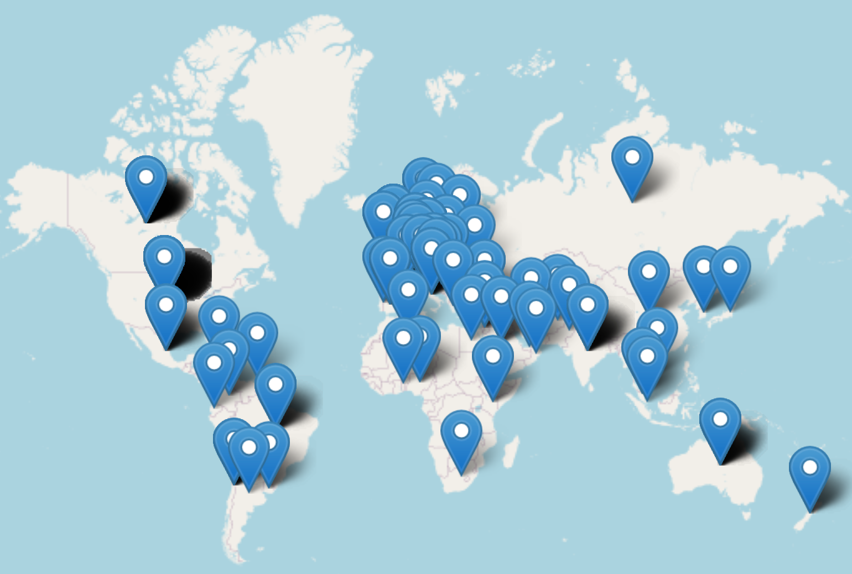

Key Stats
665 registrants, 72% show rate
34% non-US (60 countries!)
17% physicians
13% growth from previous year
$32,000 revenue from registration and sponsorships
6 Workshops (up from 2 the previous year)
First time offering CME credit!
Platforms
Zoom for pre-conference workshops
Crowdcast for main conference
SpatialChat for posters and BoF sessions
Slack for behind the scenes communication
Other highlights
36 keynotes (2) and talks
19 posters
12 BoF sessions
64 submitted abstracts
33 (52%) accepted
Notes:
We will start tomorrow with the fourth theme, R in Clinical Practice, with a Keynote by Ewen Harrison, followed by a panel discussion, and contributed presentation by Steve Master, Cass Wilkinson Saldana, Joy Payton and Paulette McRae, Ted Ladera, and Dan Holmes.

Slide 3

https://r-medicine.org
Notes:
We will start tomorrow with the fourth theme, R in Clinical Practice, with a Keynote by Ewen Harrison, followed by a panel discussion, and contributed presentation by Steve Master, Cass Wilkinson Saldana, Joy Payton and Paulette McRae, Ted Ladera, and Dan Holmes.

